Slide 1
DAT 500S Module 11
Textbook Quiz:
Exercise 10.7: Problem 2
Group Assignment:
Exercise 10.7: Problem 11
Take-home Individual Assignment:
Exercise 10.7: Problem 9

Slide 2
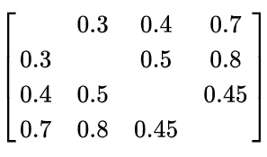
Quiz: Exercise 10.7: Problem 2
Suppose that we have four observations, for which we compute a dissimilarity matrix, given by
For instance, the dissimilarity between the first and second observations is 0.3, and the dissimilarity between the second and fourth observations is 0.8.

Slide 3
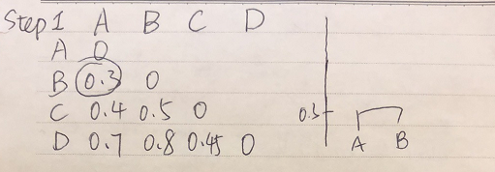
Quiz: Exercise 10.7: Problem 2
On the basis of this dissimilarity matrix, sketch the dendrogram that results from hierarchically clustering these four observations using complete linkage. Be sure to indicate on the plot the height at which each fusion occurs, as well as the observations corresponding to each leaf in the dendrogram.
Complete Linkage:Largest distance between observations in different clusters

Slide 4
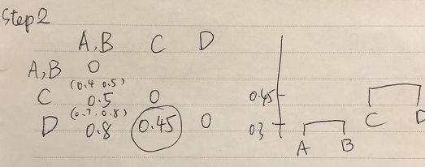
Quiz: Exercise 10.7: Problem 2
On the basis of this dissimilarity matrix, sketch the dendrogram that results from hierarchically clustering these four observations using complete linkage. Be sure to indicate on the plot the height at which each fusion occurs, as well as the observations corresponding to each leaf in the dendrogram.

Slide 5
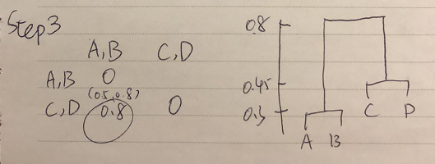
Quiz: Exercise 10.7: Problem 2
On the basis of this dissimilarity matrix, sketch the dendrogram that results from hierarchically clustering these four observations using complete linkage. Be sure to indicate on the plot the height at which each fusion occurs, as well as the observations corresponding to each leaf in the dendrogram.

Slide 6
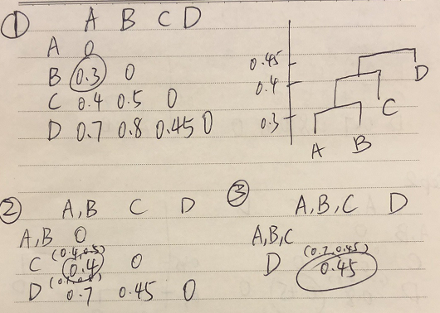
Quiz: Exercise 10.7: Problem 2
(b) Repeat (a), this time using single linkage clustering.
Single Linkage: Smallest distance between observations

Slide 7
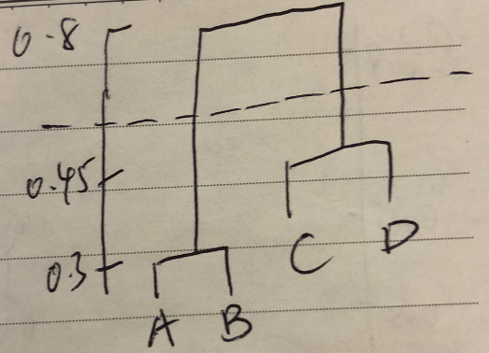
Quiz: Exercise 10.7: Problem 2
(c) Suppose that we cut the dendrogram obtained in (a) such that two clusters result. Which observations are in each cluster?
Cluster 1: A,B
Cluster 2: C,D

Slide 8
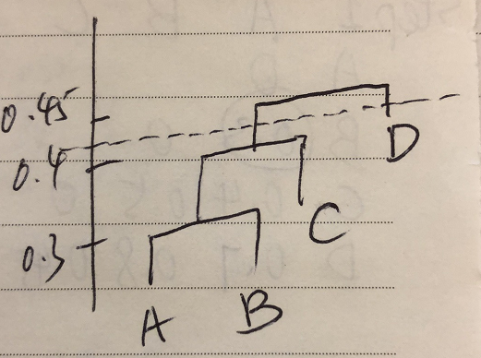
Quiz: Exercise 10.7: Problem 2
(d) Suppose that we cut the dendrogram obtained in (b) such that two clusters result. Which observations are in each cluster?
Cluster 1: A,B,C
Cluster 2: D

Slide 9
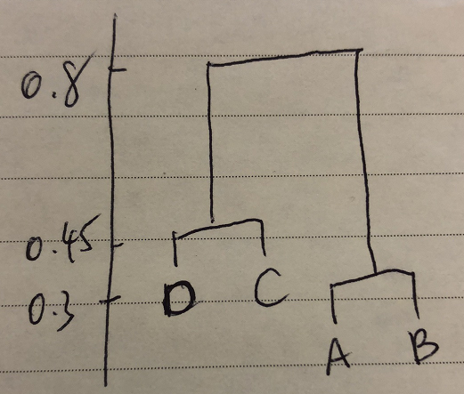
Quiz: Exercise 10.7: Problem 2
(e) It is mentioned in the chapter that at each fusion in the dendrogram, the position of the two clusters being fused can be swapped without changing the meaning of the dendrogram. Draw a dendrogram that is equivalent to the dendrogram in (a), for which two or more of the leaves are repositioned, but for which the meaning of the dendrogram is the same.

Slide 10
Group Assignment: Exercise 10.7: Problem 11
On the book website, www.StatLearning.com, there is a gene expression data set (Ch10Ex11.csv) that consists of 40 tissue samples with measurements on 1,000 genes. The first 20 samples are from healthy patients, while the second 20 are from a diseased group.
Load in the data using read.csv(). You will need to select header=F.

Slide 11
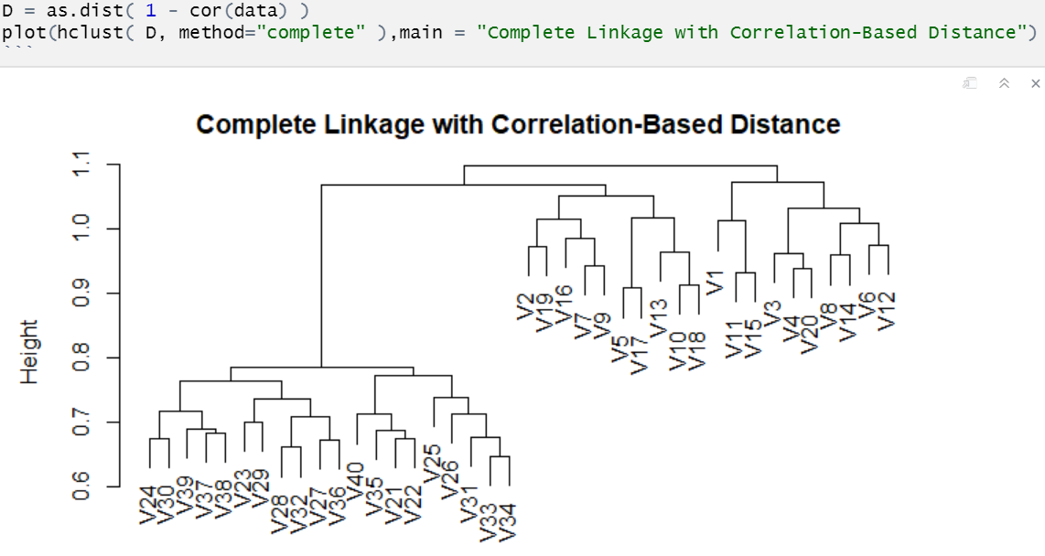
Group Assignment: Exercise 10.7: Problem 11
(b) Apply hierarchical clustering to the samples using correlation-based distance, and plot the dendrogram. Do the genes separate the samples into the two groups? Do your results depend on the type of linkage used?
Using Complete linkage

Slide 12
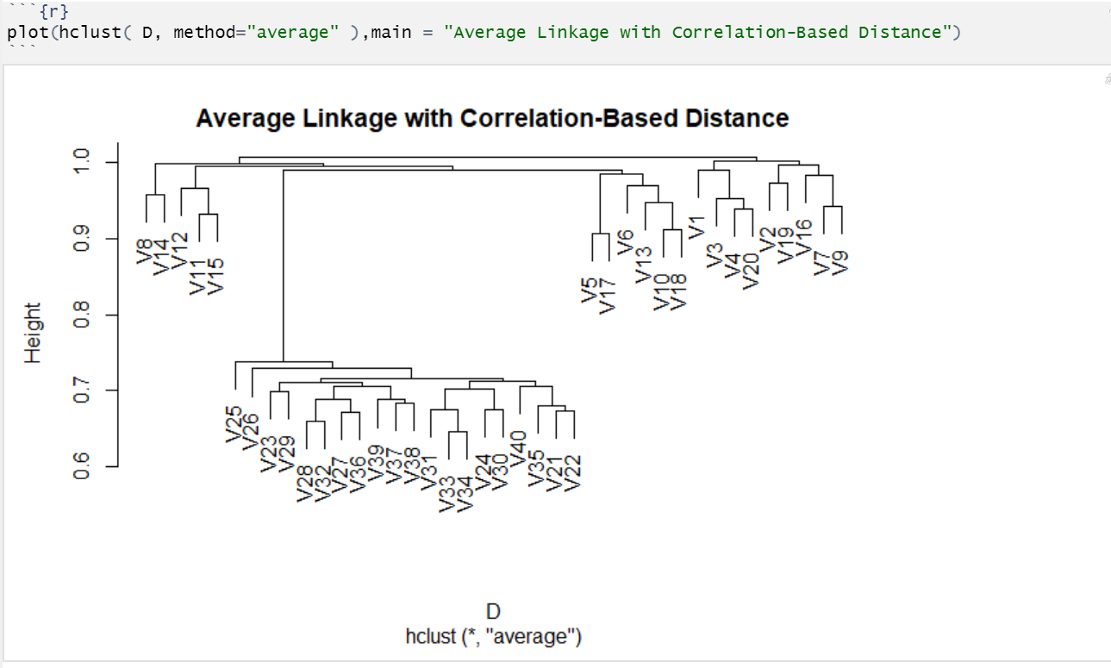
Group Assignment: Exercise 10.7: Problem 11
(b) Apply hierarchical clustering to the samples using correlation-based distance, and plot the dendrogram. Do the genes separate the samples into the two groups? Do your results depend on the type of linkage used?
Using Average linkage

Slide 13
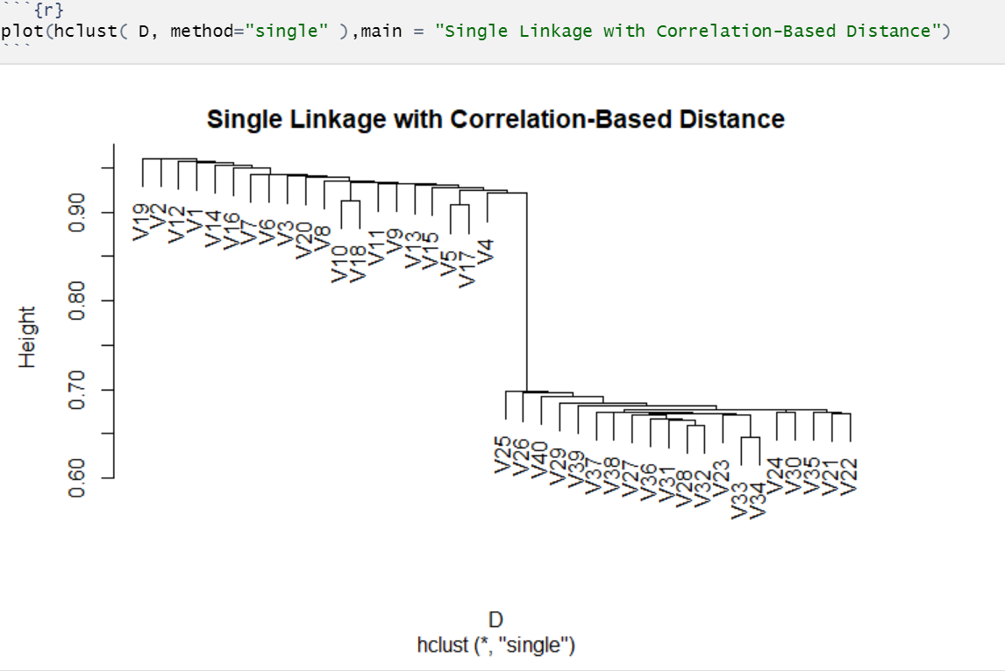
Group Assignment: Exercise 10.7: Problem 11
(b) Apply hierarchical clustering to the samples using correlation-based distance, and plot the dendrogram. Do the genes separate the samples into the two groups? Do your results depend on the type of linkage used?
Using Single linkage

Slide 14
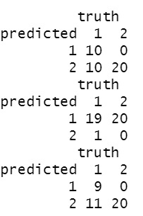
Group Assignment: Exercise 10.7: Problem 11
(b) Apply hierarchical clustering to the samples using correlation-based distance, and plot the dendrogram. Do the genes separate the samples into the two groups? Do your results depend on the type of linkage used?
To evaluate how well clustering separate the samples into the two groups:
c(rep (1,20), rep(2,20))
This creates a vector where first 20 observations are healthy (1) and the last 20 observations are diseased (2). We then can use table to compare the clustered results and the true result

Slide 15
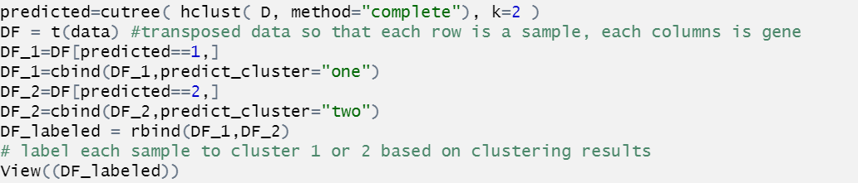
Group Assignment: Exercise 10.7: Problem 11
(c) Your collaborator wants to know which genes differ the most across the two groups. Suggest a way to answer this question, and apply it here.
label columns as cluster 1 and cluster 2
transpose the data and consider 1000 genes as 1000 predictors.
Use random forest with number of predictors to be small (like 5) to classify the cluster number. Include a large number of trees in the forest.
Look at the variable importance score to identify the genes that have high prediction power. They differ the most across the clusters.

Slide 16
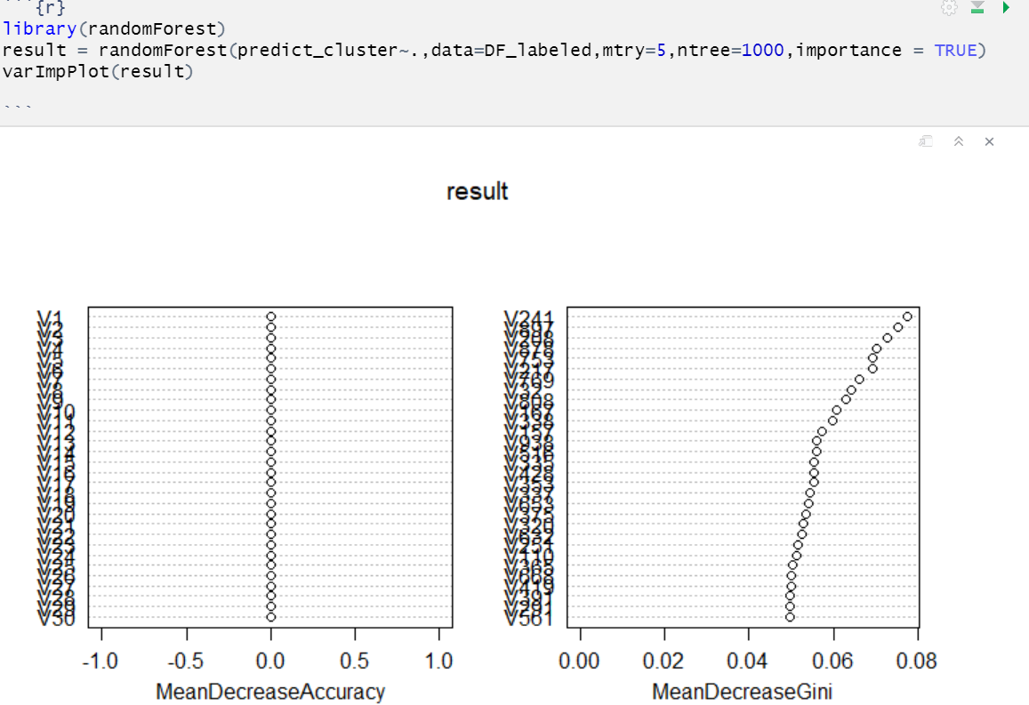
Group Assignment: Exercise 10.7: Problem 11
(c) Your collaborator wants to know which genes differ the most across the two groups. Suggest a way to answer this question, and apply it here.

Slide 17
Group Assignment: Exercise 10.7: Problem 11
(c) Your collaborator wants to know which genes differ the most across the two groups. Suggest a way to answer this question, and apply it here.
Perform a Principal Components Analysis to find out what are the most important genes in this case that caused the difference. Find out which genes are used to explain the variance and sorted them by loading vectors from Principal Components Analysis.

